Slide 1

Presented By:
S.Spoorthi Reddy (25RH1A66U7)
T.Divya Dakshitha (25RH1A66W2)
T.Geetha Sharanya(25RH1A66W1)
Department : AI&ML
Section : ‘E’

Slide 2


Slide 3
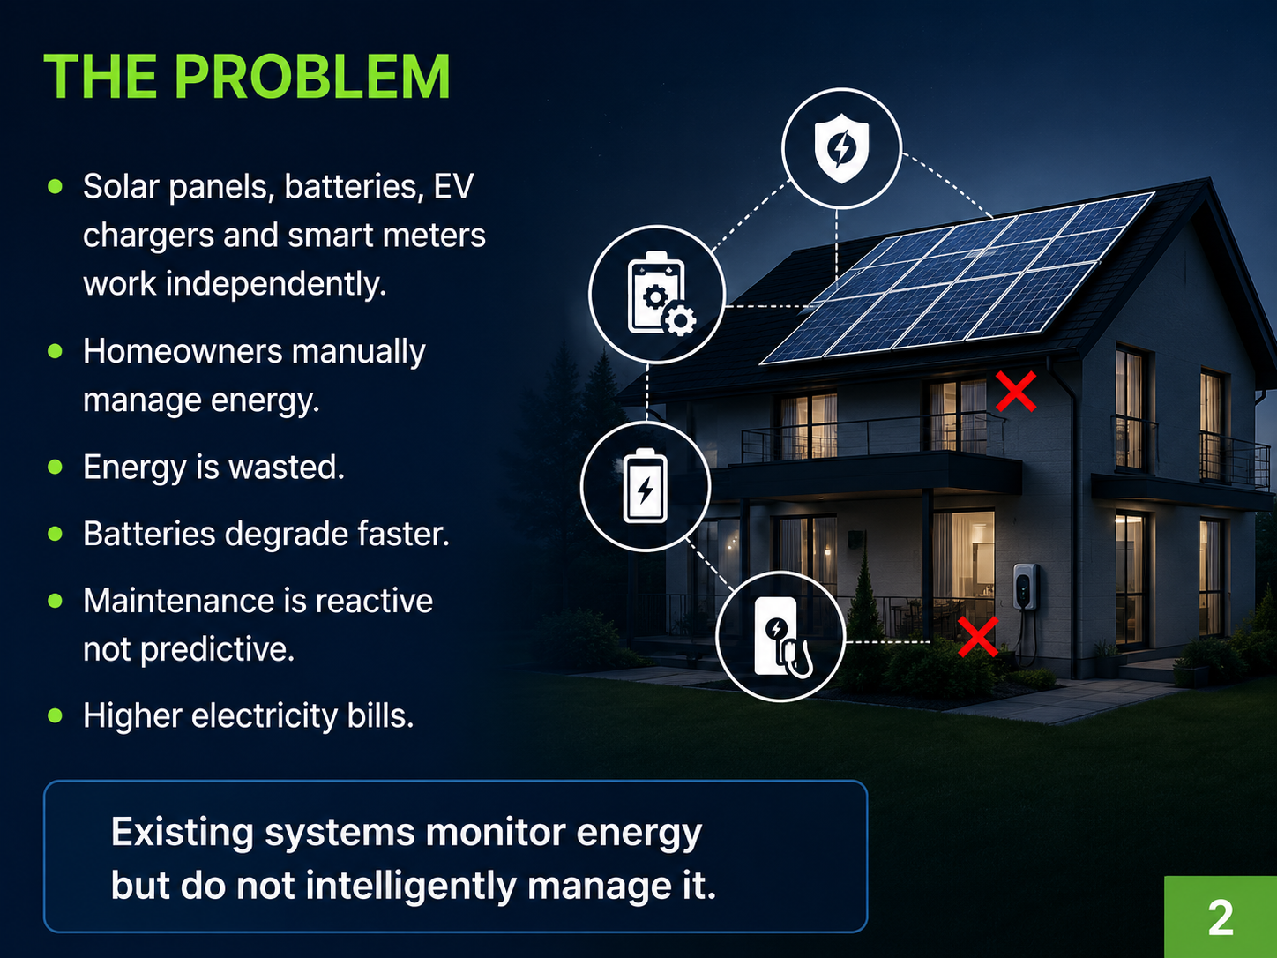

Slide 4
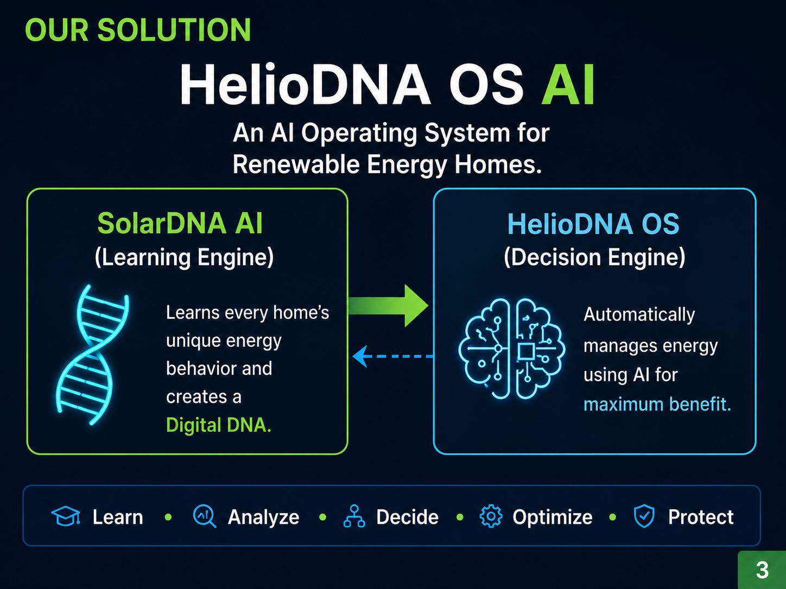

Slide 5
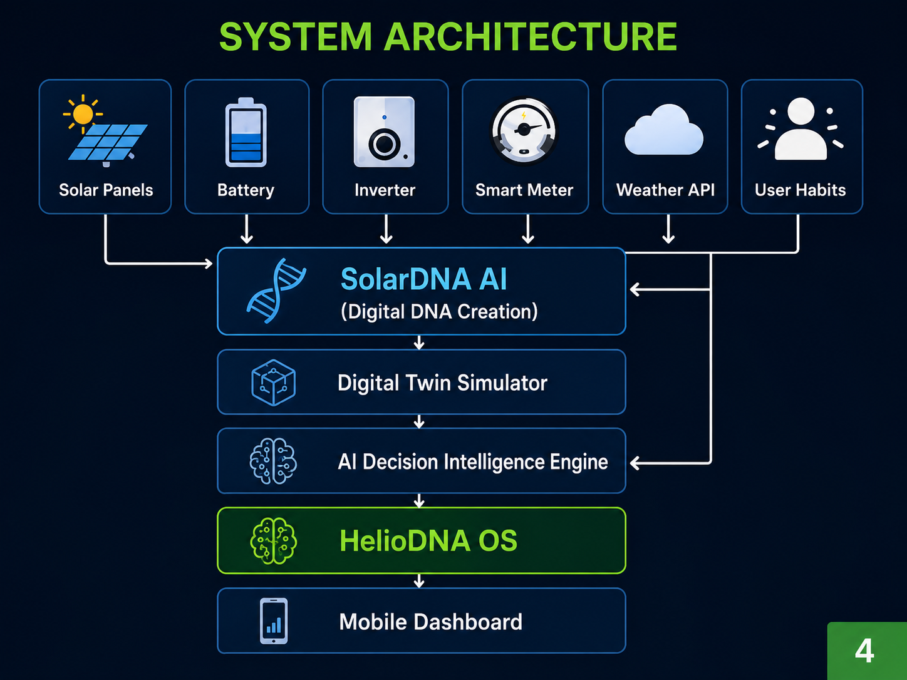

Slide 6
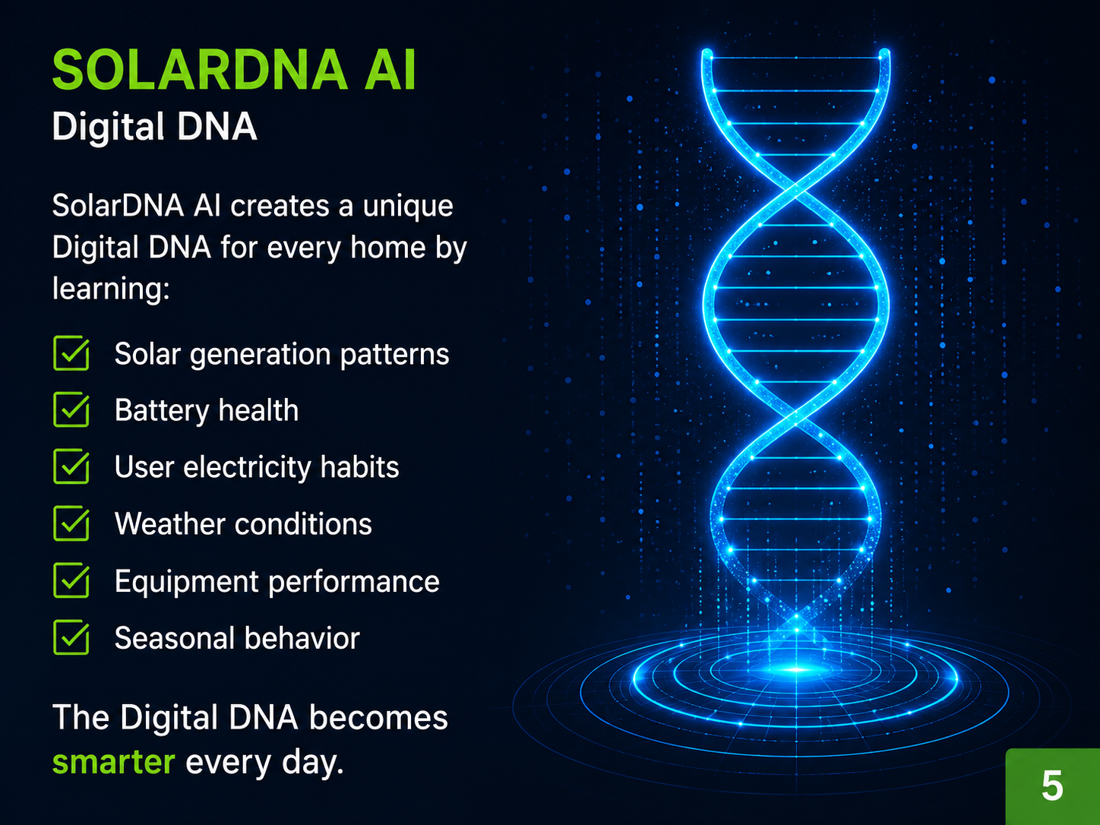

Slide 7
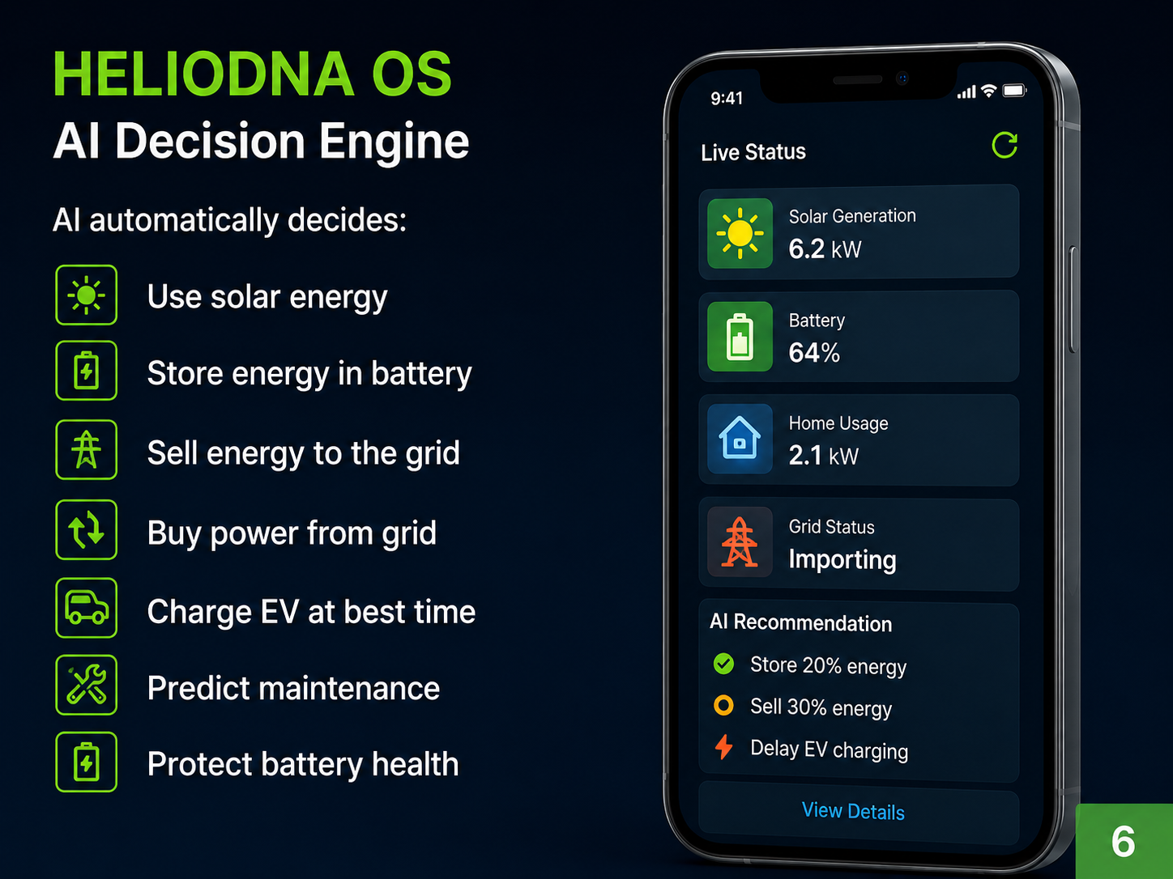

Slide 8
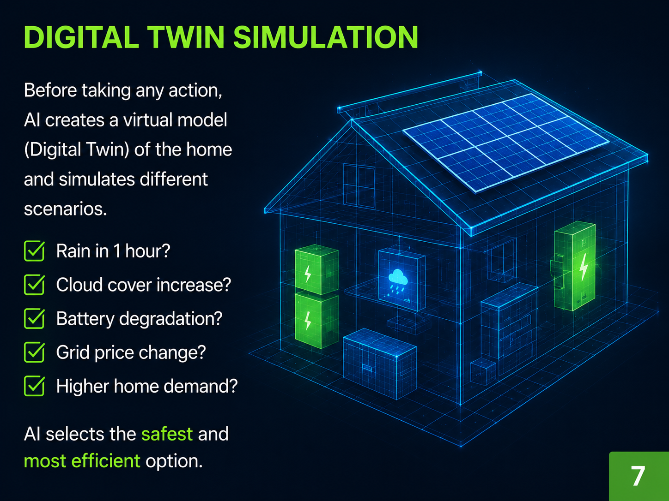

Slide 9
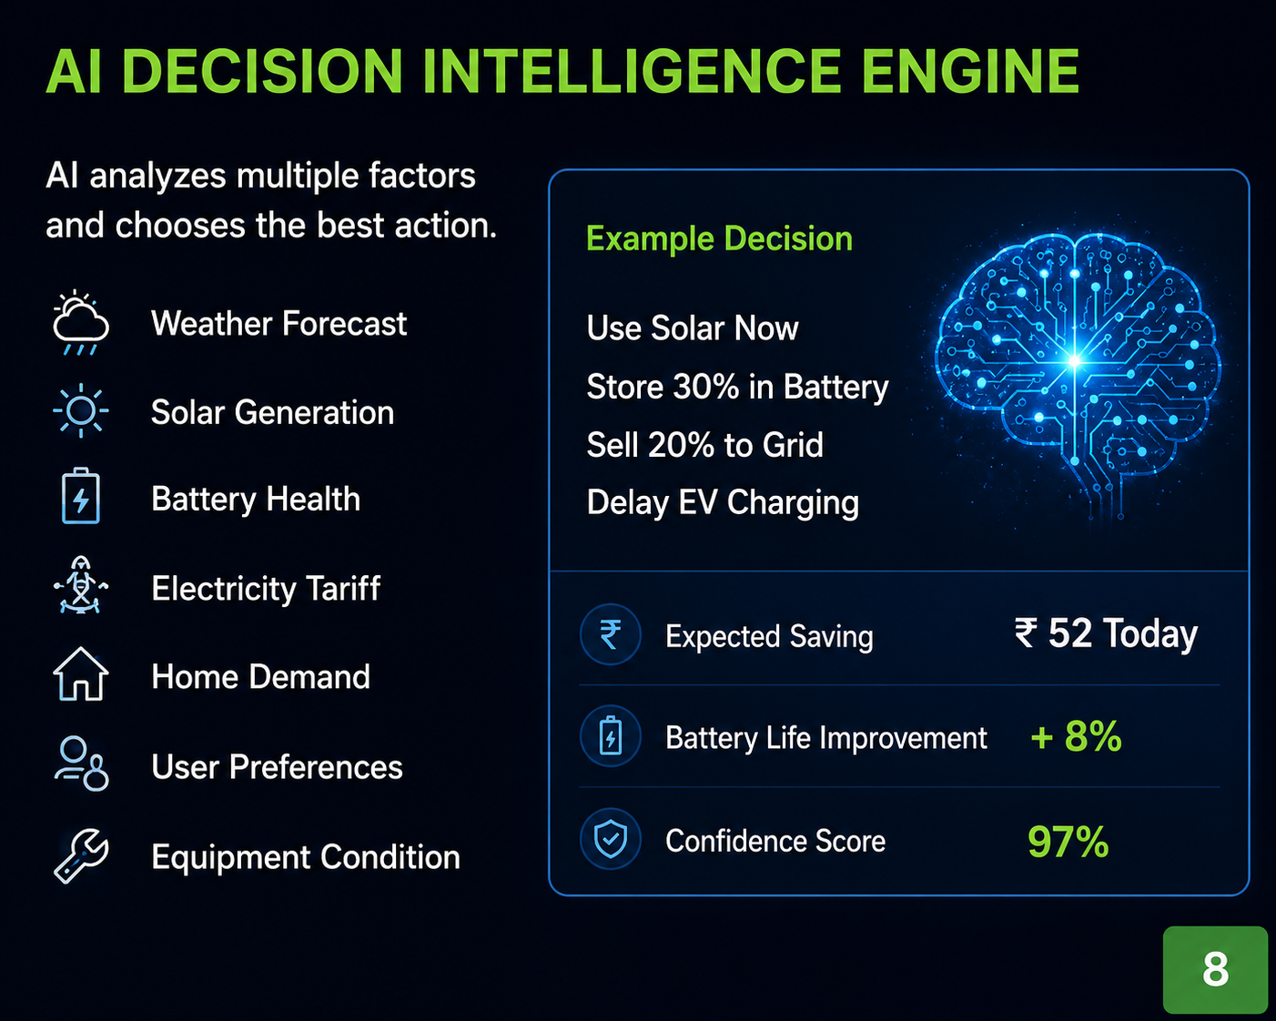

Slide 10
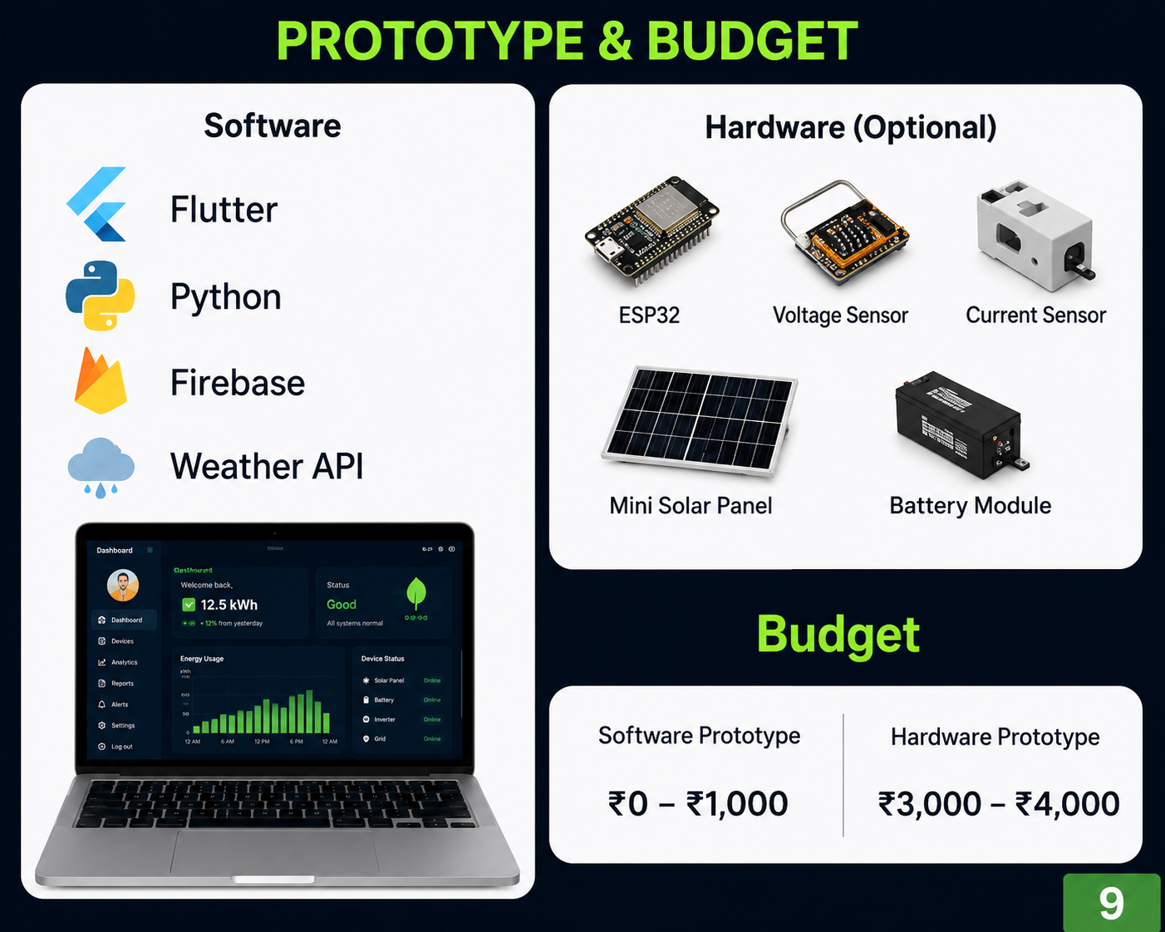

Slide 11


Slide 12


Slide 13


